Slide 1
MIS 636
Final Team Presentation
Team F
Aalisha Sheth
Bhargav Kulkarni
Kiran Kumar Venugopal Reddy
Saketh Patibandla
Samuel Mathew

Slide 2

1.
Introduction
Forever Collectibles

Slide 3

Forever Collectibles?
Leading manufacturer of sports and entertainment merchandise.
How the business works:
Major sports licenses
Powerful infrastructure
Broad variety of products
The key to success for Forever Collectibles’ are:
Bring fresh designs
Initiate manufacturing techniques
Notes:
Overview of Forever Collectibles:
Forever collectibles also known as Team Beans owned and operated by Michael Lewis, started their operation in 1999 with few hard working young people.
Today FC is one of the most innovative companies in the sports collectible industry with products for NFL, NHL, MLB, NBA, NCAA colleges and universities.
In 2011, FC made a major acquisition of Home win in UK and established FC UK.
Currently they manufacture and distribute their products in US, UK and Canada.
They manufacture majority of their products in Asia, mainly in China and Vietnam.
Even though it is a successful business with international presence, the company faces lots of challenges from different areas of their business cycle, such as pre-production, product development, sales and marketing and customer service.

Slide 4

Company Profile
Leading manufacturer of sports and entertainment merchandise.
Forever Collectibles is also know an “Team Beans” is a privately owned and operated LLC with their headquarters in Somerset, NJ.
FC was established in 1998 in Montclair, NJ.
FC is one of the most innovative companies in the sports collectible industry with products for NFL, NHL, MLB, NCAA Colleges and universities.
FC design, manufacture and market their products in US, UK and Canada.
The company's products ranges from championship trophies to commemorative bobbleheads, holiday ornaments, reusable bags, slippers, hats, Jackets, ugly sweaters and gnomes.

Slide 5
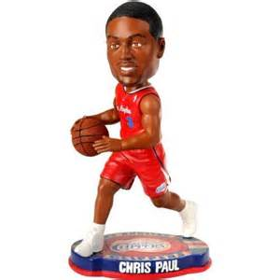
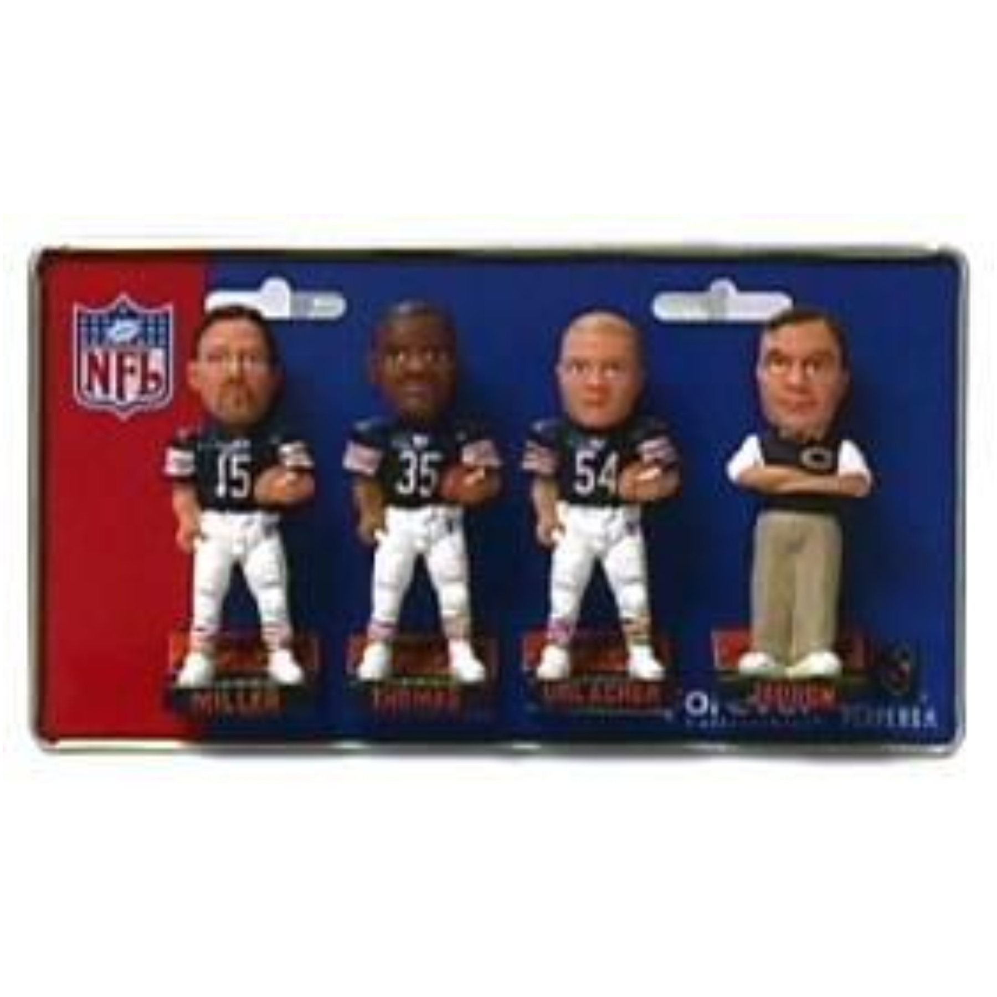
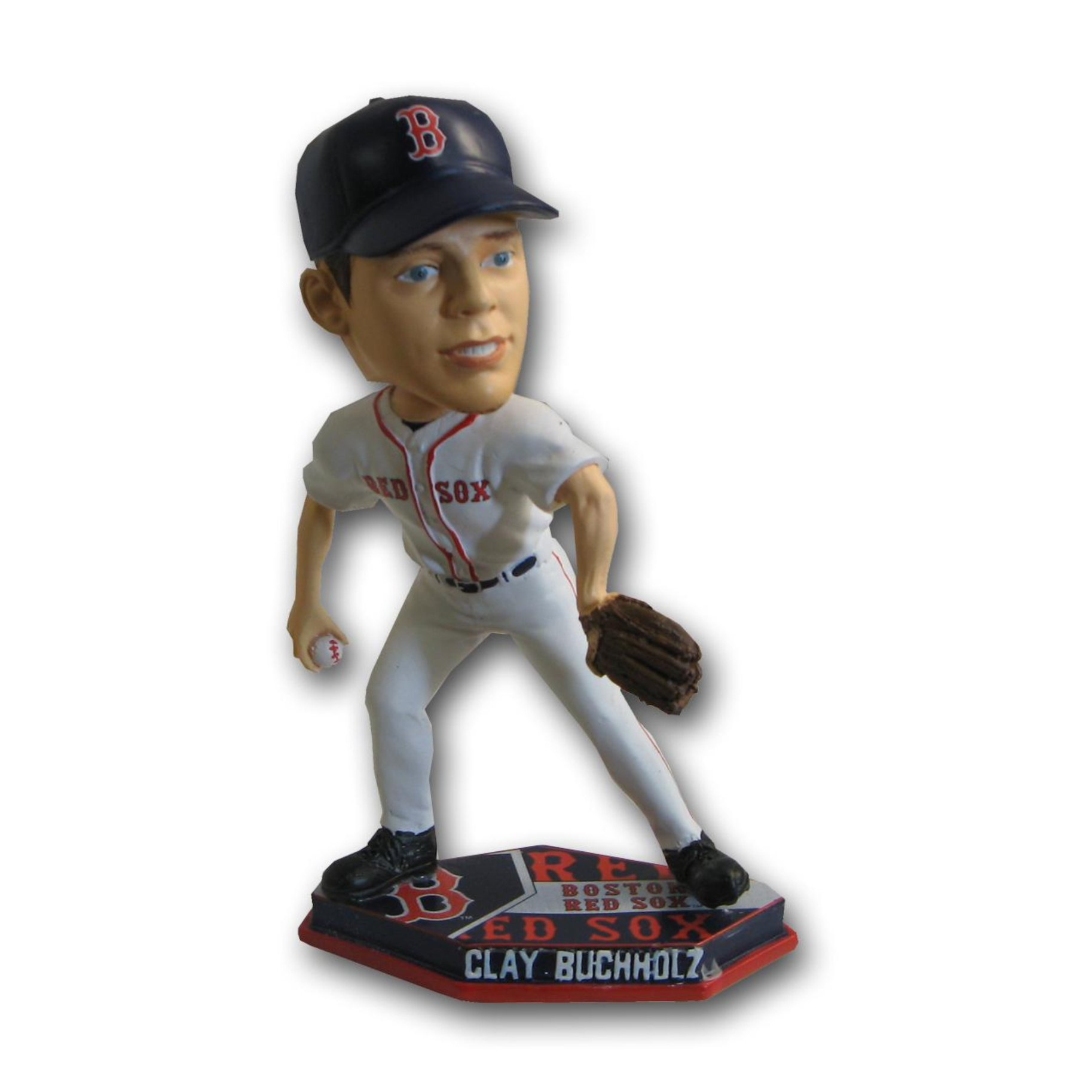
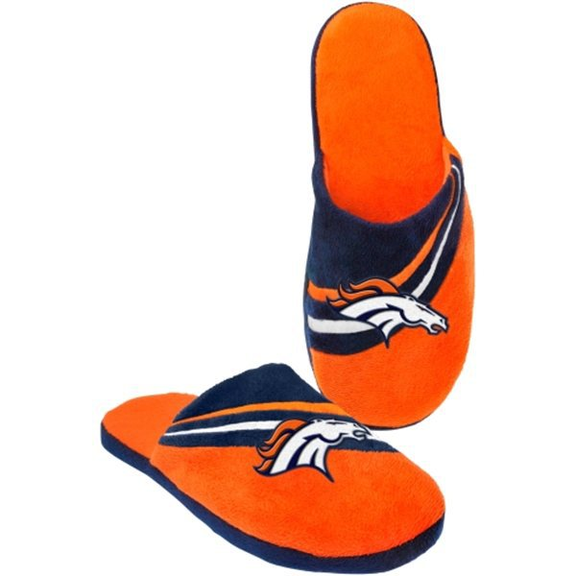
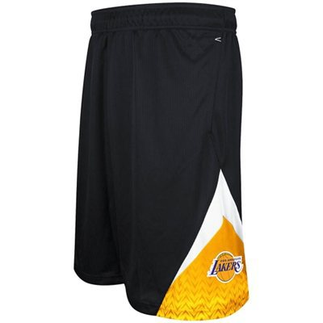
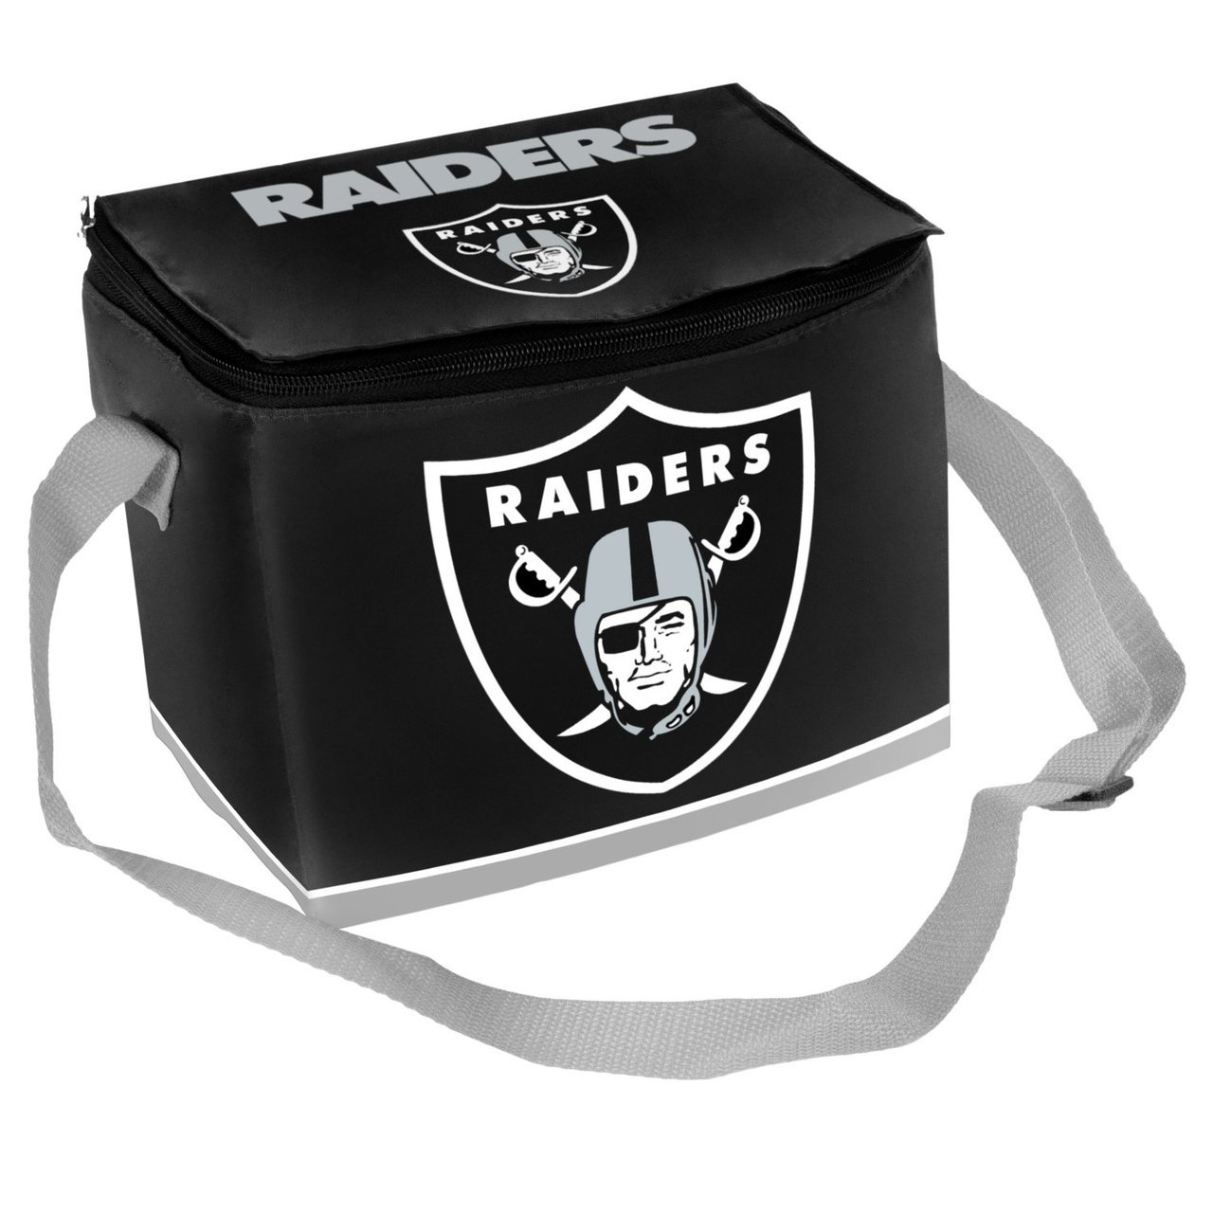
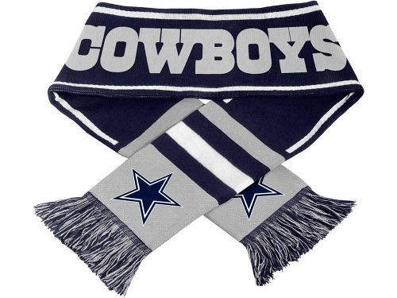
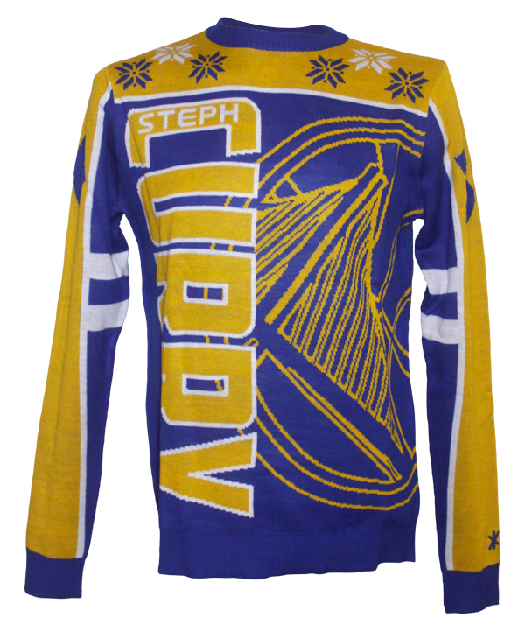
Sample Products

Slide 6
Existing System(s)
They do not have any BI solutions currently in place.
FC uses Microsoft Dynamics GP as their ERP system with MS SQL Server as the database backend.
FC uses Microsoft SQL Server Reporting Services for all their data mining.
They have a web-based portal which enable the internal & external sales force to access the sales related data from anywhere.
Major avenues of Sales : by their sales force, market place such as eBay, Amazon, & Wal-Mart.
They are launching a Business-Consumer e-Commerce system under the new brand called “FOCO” (http://FOCO.com) in the 1st Quarter of 2017.

Slide 7
Proposed Solution
Based on the transactional data and the end goal of the data a Star schema Data Mart is created to divide the present data set into 2 different fact tables
Sales Summary fact
Sales detailed fact
Both of which will have a number of dimension tables attached to it to store the dimension values. Once the Star schema data mart is created we had to identify the tables from the source (transactional) database which will fit these fact and dimension tables.
Once these tables/fields were identified the data was copied from the transactional DB to the Star schema we have created at their respective fields. This star schema gives us a good command over the data to derive analytics over it and make a few dashboards using the data in it from different perspectives such as Executive, Salesperson, Customer.
As part of the project we created 4 dashboards

Slide 8
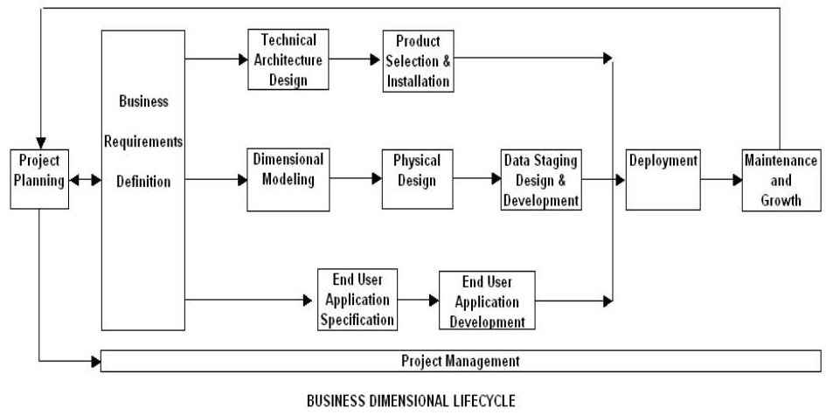
Business Lifecycle Approach

Slide 9
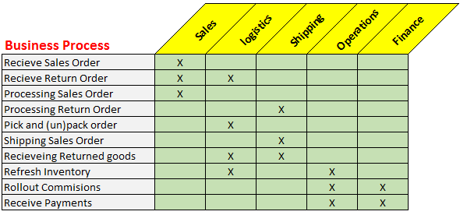
Opportunity Matrix

Slide 10
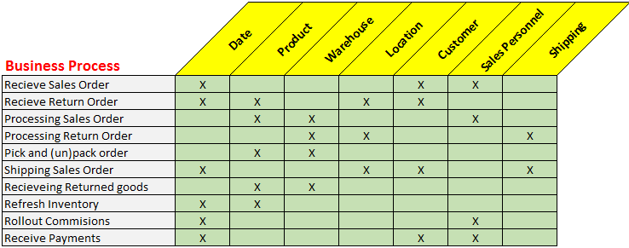
Bus Architecture Matrix

Slide 11
Prioritization Grid
high
Business
Impact
Receive payments
Rollout commision
Receiving Returned goods
Receive Sales order
Processing Sales order
Pick and (un)pack items
Shipping Sales order
Refresh inventory
Processing Return order
Receive Return order
low
Feasibility
high

Slide 12
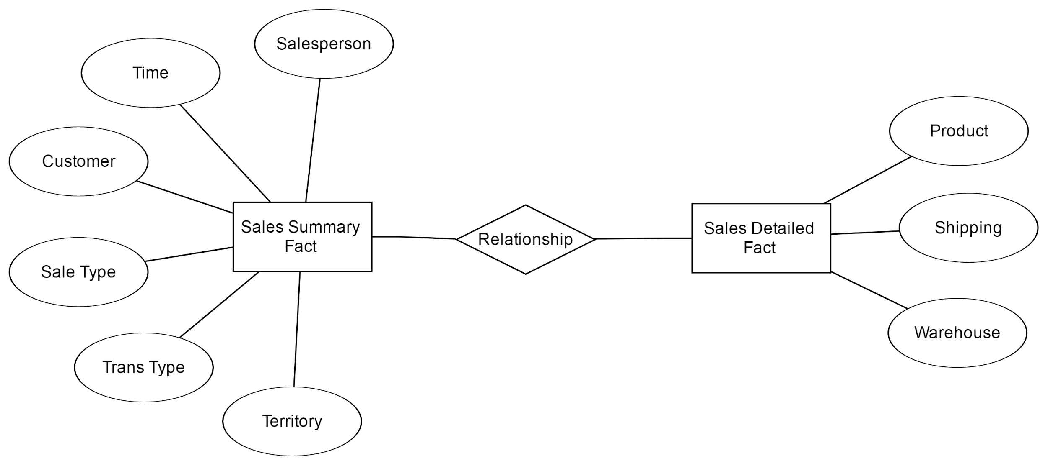
Logical Fact Diagram
Notes:
Transaction Type: Quote, Order, Invoice and Return
Sales Type : Open/Work | Historical

Slide 13
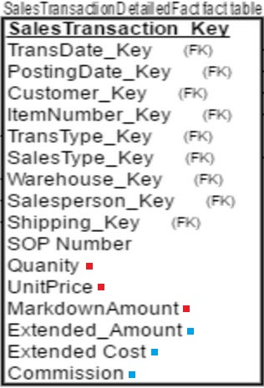
Detailed Fact Table
Dimensions are the key aspects related to a fact table and where the data is extracted for most of the elements of the fact tables.
Basic Variables
Derived Variables
Commission - Sales Amount *Commision Rate %

Slide 14
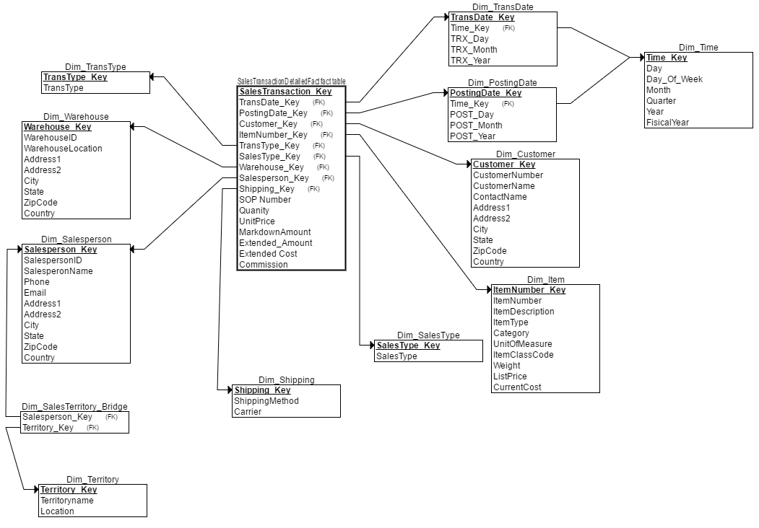
Star Schema

Slide 15
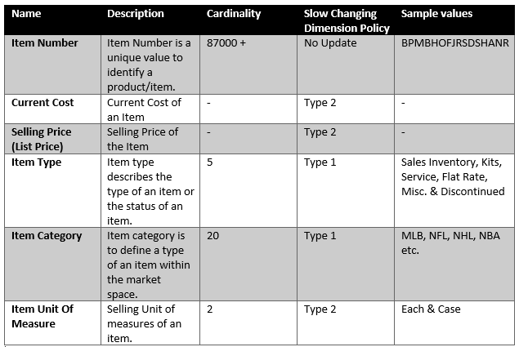
Dimension Attribute Detailed Description: Item Dimension
Notes:
-> Item units of measure - Can sell individually or as cases
-> Item Type - type & status
-> Type -> I, no changes possible and II, it is susceptible to change.

Slide 16
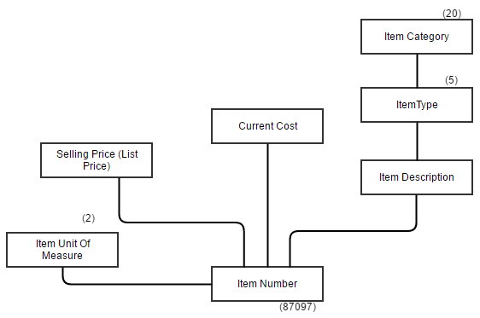
Detailed Dimension table Diagram: Item Dimension

Slide 17
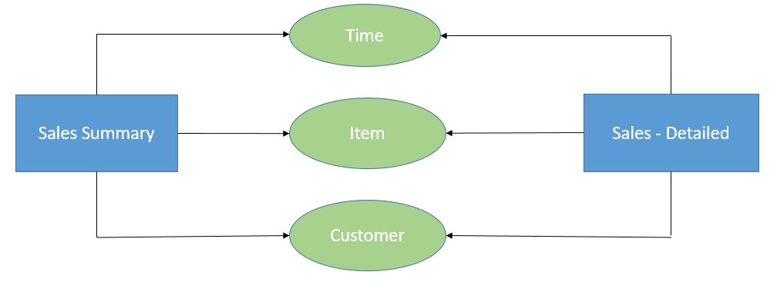
Conformed Dimension
Conformed dimension is the dimension which has the same meaning and contents when being referred from different fact tables.
In our dimension modeling, we have the the following Conformed Dimensions -
Time Dimension
Item Dimension
Customer Dimension
Notes:
In data warehousing, a conformed dimension is a dimension that has the same meaning to every fact with which it relates. Conformed dimensions allow facts and measures to be categorized and described in the same way across multiple facts and/or data marts, ensuring consistent reporting across the enterprise.

Slide 18
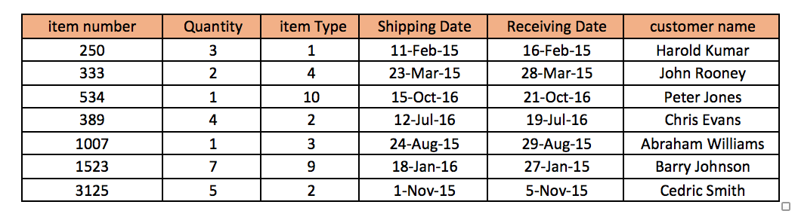
Two Way Aggregate Table

Slide 19

OLAP MDDB Cube
Fiscal Year
2016(2)
2016(1)
2015(2)
2015(1)
NFL
NHL
Business Category
MLB
NBA
Eastern
The dimension Business Category, Time Zone and Fiscal Year are all Dense Dimensions
Central
Mountain
Time zone
Pacific

Slide 20
Dimension Hierarchy:Year
First Half
First Quarter
Second Quarter
Jan
Feb
Mar

Slide 21
Dimension Hierarchy:Region
Time Zone
California
New York
North Carolina
Texas
Austin
Houston
Dallas

Slide 22

2.
Dashboard
Business Intelligence

Slide 23

What is Business Intelligence?
“BI is a data analysis process aimed at boosting business performance by helping corporate executives and other end users make more informed decisions”
www.techtarget.com

Slide 24
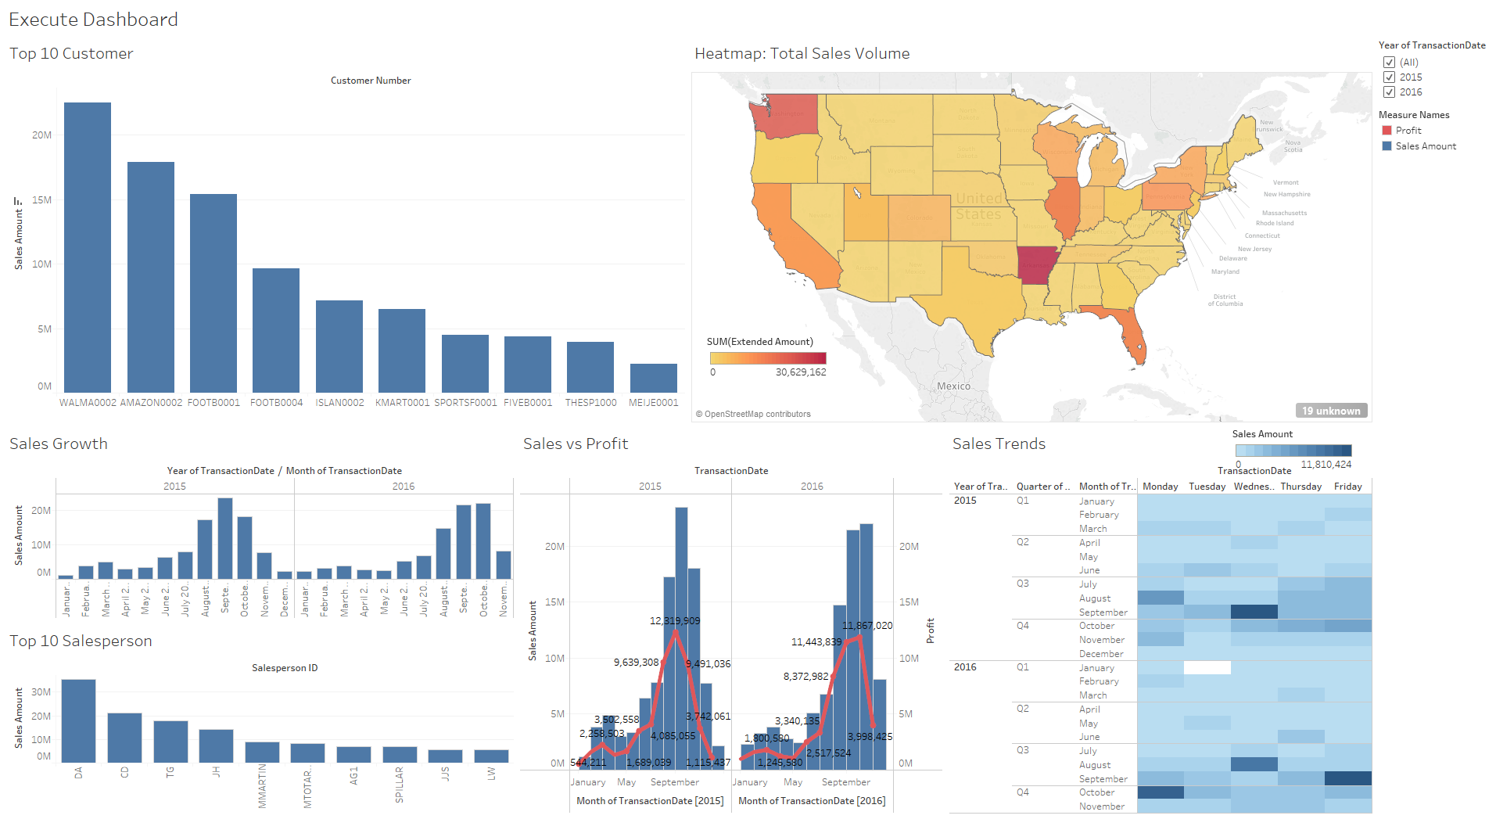
Executive Dashboard

Slide 25
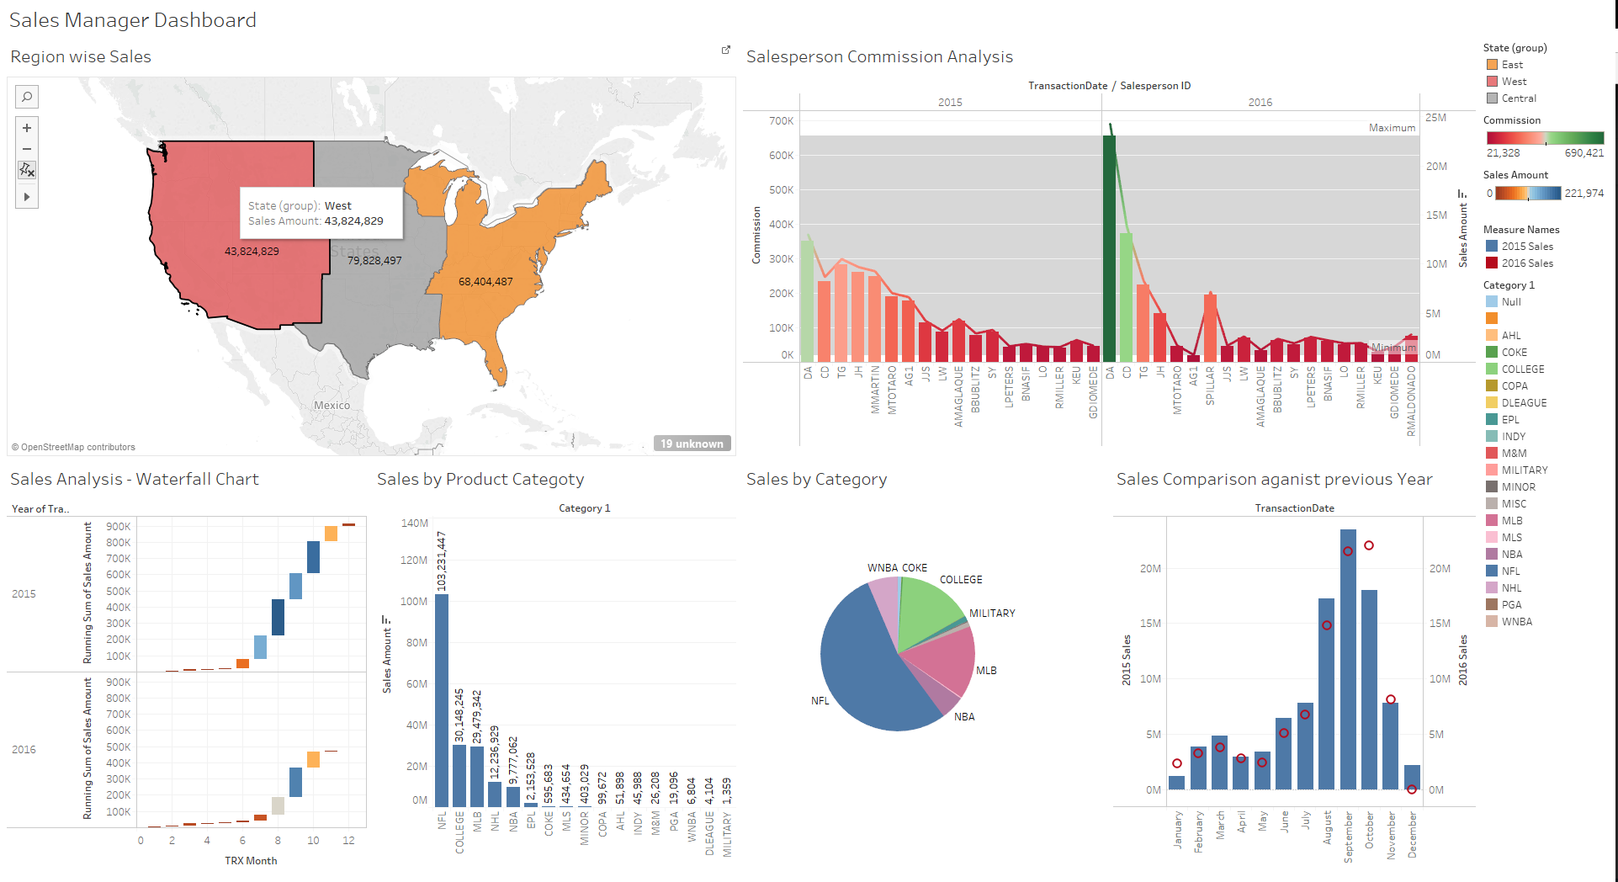
Sales Manager Dashboard

Slide 26
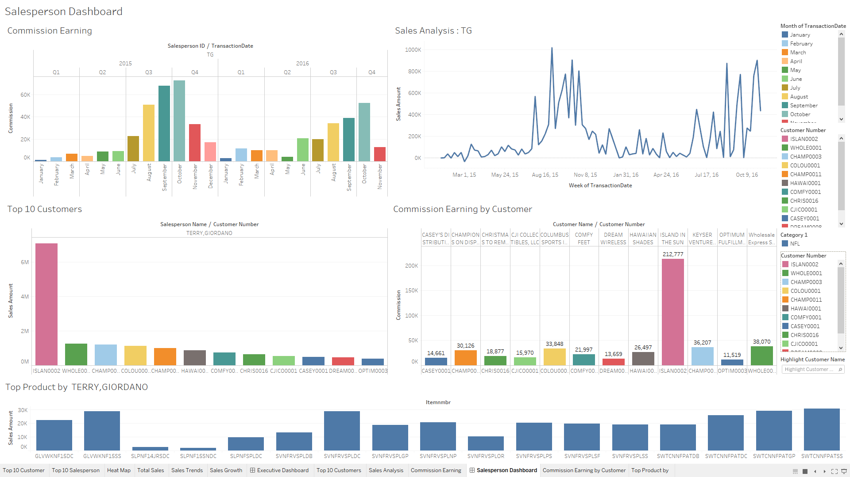
Salesperson Dashboard

Slide 27
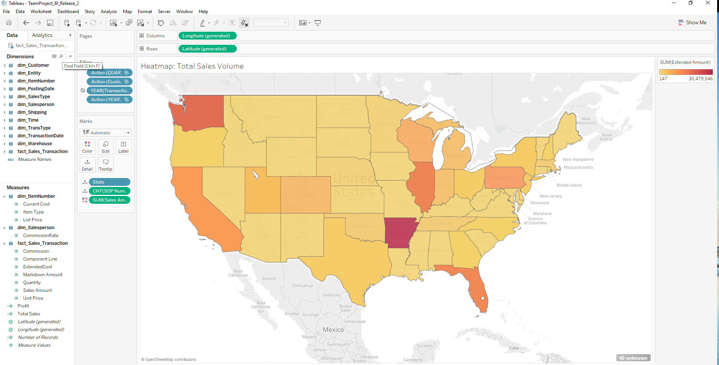
Heat Map

Slide 28
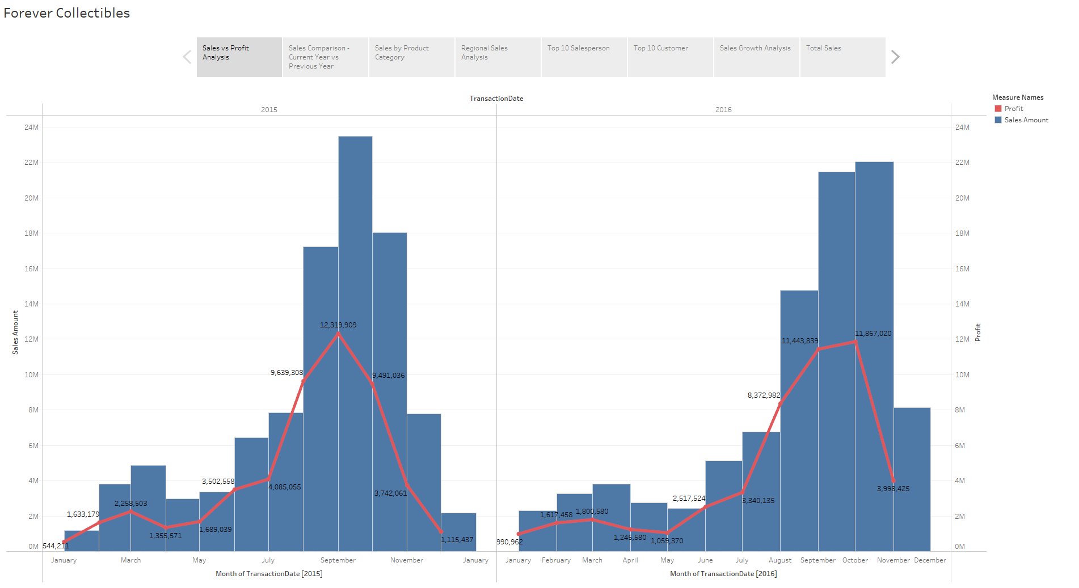
Storyboard

Slide 29
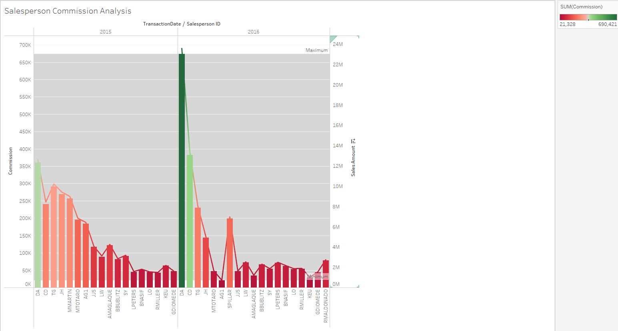

Slide 30
3.
Demo
Business Intelligence

Slide 31
Conclusion
The Company prior to this had no exposure to derive analytics over the data.
Improved Sales Information
Immediate access to key metrics reports.
Greater competitive advantage.
Gain valuable insight into your customer behaviours
Gain a better understanding of your business’s past, present & future.
Better Data Visualization
Sales Intelligence.
Notes:
With the implementation of this project, we were able to add value to the company to help derive information from its sales data.
The implementation of this project laid a foundation for the future projects by creating a data mart with consistent data. In the later projects we can create different data marts and connecting them creating a holistic view of the data.

Slide 32

Thanks!
Any questions?

